Slide 1
85th Texas Legislature
Outcomes & Analyses
Healthcare Landscape 2018

Slide 2
Overview
Major Legislative Priorities
  Maintaining Funding for Enhanced Medicaid Payments
  Supporting Texas Trauma Hospitals
  Investing in the Behavioral Health System
  Funding for Health Care Workforce Education and Training
Other Major Issues
  Freestanding Emergency Centers
  Hospital Pricing and Disclosure
  Hospital Operations
  Physician Practice
Special Session Focus
1115 Medicaid Waiver
Notes:
NOTE: The FECs and Hospital Pricing and Disclosure slides are written for member hospitals only. Please do not use for public facing presentations or please consult with Advocacy Communications first.

Slide 3
Major Legislative Priorities

Slide 4
Maintaining Funding for Enhanced Medicaid Payments
Goal & Result: THA secured $336 million in level funding for Medicaid reimbursement rate add-ons and uncompensated trauma care costs.
Funding for Targeted Medicaid Rate Enhancements for Certain Hospitals and for Uncompensated Trauma Care Costs (in Millions)
Notes:
Despite the tight budget, THA secured $336 million in level funding for enhanced Medicaid reimbursement rates for trauma, rural and safety net hospitals and to offset some uncompensated trauma care costs for trauma hospitals.
About a third of enhanced payment appropriations comes from state general revenue. The other two thirds comes from Account 5111, which is fed by the surcharges and fees collected from the Driver Responsibility Program.

Slide 5
Supporting Texas Trauma Hospitals
Goal: Preserve trauma hospital funding but replace the source of funding.
Result: Killed at the 11th hour, THA’s favored solution would have:
  Repealed the Driver Responsibility Program and the program’s surcharges;
  Implemented new source of revenue for trauma hospitals; and
  Offered local control to municipalities considering cases and fines for certain traffic violations.
Next Steps: Continue engaging lawmakers and stakeholders to agree on an alternative source of trauma funding.
Notes:
This session, the Driver Responsibility Program was the center of bipartisan efforts to repeal or dilute the program because of the onerous traffic surcharges and fines it imposes.
About 300 Texas hospitals are designated trauma centers that rely on the unpopular DRP, as it is the source for uncompensated trauma care payments.
THA led a coalition of Texas counties, criminal justice advocates, law enforcement and other stakeholders to identify an alternative to the DRP and an alternative source for trauma hospital funding.
THA also engaged the public through a grassroots advocacy campaign to generate support for state funding for trauma hospitals.
THA supported House Bill 2068 by Rep. Larry Phillips (R-Sherman) as it would have repealed the DRP, replaced lost trauma funding with new revenue and was favored by the counties and other advocates.
Unfortunately, the DRP replacement efforts were derailed at the 11th hour by an amendment that ultimately killed the bill.
Since the bill died, the DRP continues as is.

Slide 6

Investing in the Behavioral Health System
Goals: Improve access to mental health and substance abuse treatment by:
  Establishing a statewide mental health parity law;
  Growing the substance use provider workforce; and
  Building on 84th Legislature’s behavioral health funding.
Notes:
Getting needed treatment for anxiety, depression, bipolar disorder or a substance use problem has long been difficult in Texas. Almost two million adult and youth Texans need substance use treatment and about a million more need mental health treatment. Yet, only a fraction actually get the care they need.
The severe shortage of behavioral health providers, long waitlists for services and insurance challenges are pervasive barriers to behavioral health treatment.
At the recommendation of THA’s Behavioral Health Council, THA set out to and succeeded in establishing a statewide mental health parity law, growing the substance use provider workforce and securing enhanced behavioral health funding.
THA worked with Rep. Four Price (R-Amarillo) to help pass his House Bill 10, which establishes mental health parity in Texas so that health plans treat mental health and physical health conditions fairly. The bill gives the Texas Department of Insurance authority to enforce the existing federal parity law and creates an ombudsman at the Texas Health and Human Services Commission to help providers and consumers better navigate the behavioral health system and report parity breaches or concerns. The bill also creates a study so that the legislature can better understand the insurance challenges associated with attaining behavioral health treatment. The bill passed the Texas Legislature and was sent to the Governor’s desk for signature in the final days of session.

Slide 7
Investing in the Behavioral Health System
Results:
  Passed a statewide mental health parity law so that behavioral health conditions are treated the same, in terms of benefits and provider networks, as physical health conditions.
  Passed a bill that grows the substance abuse provider network by making licensed chemical dependency counselors eligible for education loan repayment assistance in exchange for serving low-income and indigent Medicaid and CHIP clients.
  The Texas Legislature invested $7.5 billion in the state behavioral health system.
    $3.6 billion for Medicaid and CHIP behavioral health services.
    $63 million to address the current and projected waitlists for community mental health services for adults and children.
    $366 million for construction and repairs at state hospitals and other inpatient mental health facilities.
Notes:
THA also worked with Rep. Price on his House Bill 3083, which grows the substance use provider workforce by adding licensed chemical dependency counselors to the Loan Repayment Program for Mental Health Professionals, making them eligible to receive loan repayment assistance in exchange for serving indigent and low-income populations in behavioral health professional shortage areas. The bill passed the Texas Legislature and went to the Governor’s desk for signature in the final days of session.
The 85th Texas Legislature delivered potentially its most significant behavioral health investment yet. It appropriated more than $7.5 billion for behavioral health, including $3.6 billion for Medicaid and CHIP behavioral health services. Of the $4 billion appropriated for non-Medicaid behavioral health services, $63 million will be used to address the current and projected waitlists for community mental health services for adults and children, and $366 million will be used for construction and repairs at state hospitals and other inpatient mental health facilities.

Slide 8
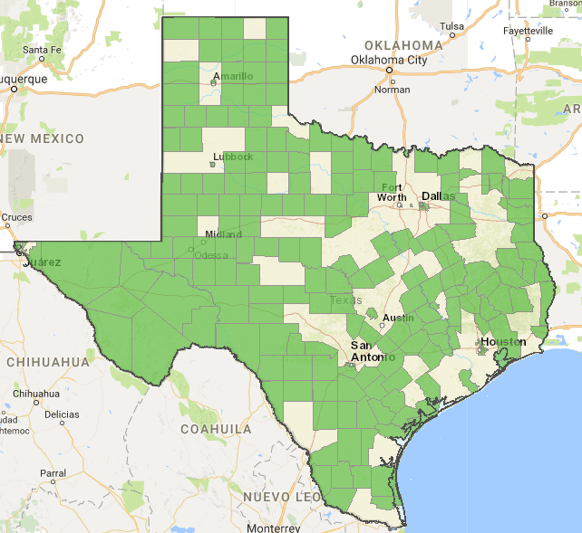
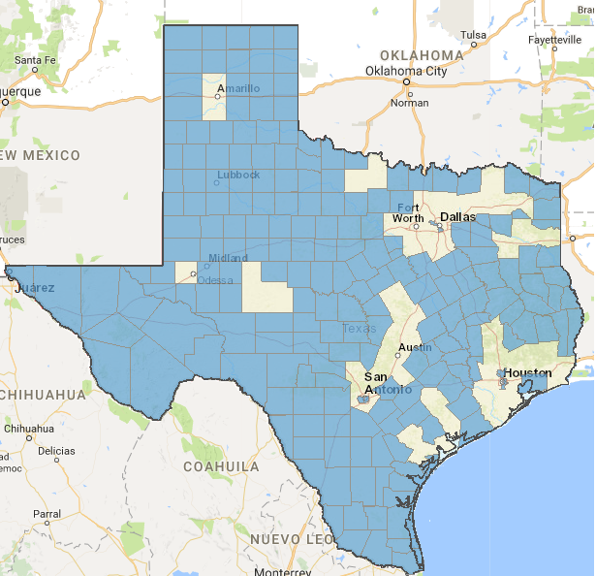
Funding for Health Care Workforce Education and Training
Goal: Address the health professional shortage by increasing education and training opportunities.
2017 Health Professional Shortage Area - Primary Care
2017 Health Professional Shortage Area - Mental Health
Source: Health Resources & Services Administration
Notes:
Texas hospitals supported continued appropriations to address the state’s critical shortage of physicians, nurses and behavioral health care professionals.
The green and blue-shaded counties represent designated health professional shortage areas.
As you can see, Texas has a severe statewide shortage of primary care physicians and is also in need of specialists, in a number of disciplines, including pediatrics, endocrinology and geriatrics.
More than 80 percent of Texas counties are designated as mental health professional shortage areas; 70 percent of counties have no practicing psychiatrists.

Slide 9
Funding for Health Care Workforce Education and Training
Result:
Physicians:
  $90 million (level funding) to continue current GME programs and add new programs at the University of Texas at Austin and Rio Grande Valley.
  $35 million in hold harmless funding to address decreased formula rates at all institutions.
  $97 million ($44 million increase) to expand GME opportunities for first-year residents and partnership grants with health facilities.
  $25 million ($8 million decrease) for the Physician Educational Loan Repayment Program.
Nurses:
  $20 million ($14 million decrease) for Professional Nursing Shortage Reduction Program.
  $11 million (level funding) in nursing school grants to recruit and retain students and faculty.
  Texas Board of Nursing sunset bill allows nurses to have a multistate license with the ability to practice in multiple states.
Mental Health:
  $2.1 million (level funding) for the Loan Repayment Program for Mental Health Professionals.
Notes:
The 85th Texas Legislature supported graduate medical education but was not quite as generous in the state budget with other health care workforce-related funding, particularly for the Professional Nursing Shortage Reduction Program, which took a $14 million hit.
Nurses did, however, secure a win with the Texas Board of Nursing sunset legislation that continues TBN until September 2029 and enacts the Nurse Licensure Compact that expands career opportunities by allowing nurses to have one multistate license with the ability to practice in their home state and other compact states.

Slide 10
Other Legislative Priorities

Slide 11
Freestanding Emergency Centers
Goal: Help consumers understand with which health plans a FEC contracts in the most effective way.
Result: THA improved legislation that would have required FECs to publicly post the list of health insurance companies with which the FEC does and does not contract.
  THA negotiated language to require website disclosure of disclosure of network participation, along with a restatement of an existing law requiring individual confirmation of network status at the time of service.
Notes:
Texas has more freestanding emergency centers than any other state – 345. More than 60 percent of these facilities are not owned by or affiliated with a Texas hospital.
FECs were subject of substantial legislative interest this session, as numerous bills were filed to require additional disclosure to consumers regarding the provider network participation of freestanding emergency centers.
To bring clarity to some of the issues surrounding FECs, THA worked to educate lawmakers on the significant differences in regulations and practice for hospital-owned FECs versus independent FECs.
THA helped kill the bills that would have required onerous disclosure procedures for hospitals and improved a bill by Rep. Tom Oliverson, M.D. (R-Cypress) that would have required both independent and hospital-affiliated FECs to publicly post the list of health insurance companies with which the FEC does and does not contract.
THA communicated the administrative burden such regulations place on hospital-affiliated FECs and successfully negotiated language to require website disclosure of network participation, along with a restatement of an existing law requiring individual confirmation of network status at the time of service.

Slide 12
Health Care Pricing and Disclosure
Goal: Offer pricing transparency to consumers in the most effective and accurate way for hospitals.
Results: THA weighed in on several related bills.
  Supported and helped pass legislation to expand the law governing mediation of disputed health care bills to include all facility-based providers, including those practicing in freestanding emergency centers.
  Raised concerns over a bill that would have allowed the attorney general to sue hospitals and FECs for “unconscionable” billing for emergency care.
  Helped kill a bill that would have required health care facilities to disclose, or in certain circumstances estimate, the cost of a nonemergency medical service before services are rendered.
Notes:
Currently, disputed claims over $500 from certain facility-based physicians practicing in ambulatory surgical centers, birthing centers or hospitals, and who are not in the patient’s health plan network, are eligible for mediation. The new law will soon open the mediation process up to claims from any facility-based or emergency care provider.
The bill defined “unconscionable” as 150 percent of the average hospital billed charge. THA did not formally oppose the bill but raised concerns that it would have created a cause of action based on billed. THA raised concerns that the bill would have created a cause of action based on billed charges, and it ultimately died.
The bill that would have required an estimation of costs would have also imposed onerous requirements on health plans, including:
providing notice to enrollees relating to cost-sharing payments;
providing a binding estimate of payments to be made for any health care service or supply upon the request of an enrollee;
establishing and operating a toll-free phone number and publicly accessible website for enrollees to request and obtain the average amount paid under the health benefit plan to a provider for a particular health care service or supply; and
paying an enrollee the lesser of 50 percent of the difference between the average amount paid for a health care service or supply and the actual cost minus any applicable deductible, copayment or coinsurance, or $7,500.
THA opposed the bill on the grounds that it would be administratively burdensome for hospitals and would duplicate many of the provisions of the existing statute related to pricing disclosure.

Slide 13
Hospital Operations
Goal: Allow hospitals to manage and run their facilities and operations to best serve patients.
Result: THA killed and improved several bad bills.
  THA killed legislation that would have subjected private hospitals to open records requests under the Public Information Act.
  THA brokered a compromise, removing language from a bill that created new causes of action for physicians to sue their 501(a) physician groups.
  THA forged a compromise, amending bill language so that hospitals can continue to determine their own physician workforce.
Notes:
This session, numerous bills were proposed that would have changed how hospitals manage and run their facilities and operations.
The Texas Hospital Association successfully opposed and improved several of these bills, and the most onerous failed to pass, including subjecting private hospitals to the requirements of the Public Information Act and creating new causes of action for physicians to sue their 501(a) physician groups. However, it is important to note that the special legislative session called by Gov. Greg Abbott (R) to handle the sunsetting of the Texas Medical Board could allow the 501(a) issue to reemerge as it is physician related and could be considered germane to the TMB discussion.
After a 2015 Texas Supreme Court ruling overturned almost 30 years of case law governing when certain private companies that receive public money are required to produce records to the public, Sen. Kirk Watson (D-Austin) and Rep. Rep. Giovanni Capriglione (R-Southlake) received strong support for their bills that would have restored the previous attorney general test that was more likely to subject private organizations to the PIA. THA and its member hospitals expressed strong opposition to the bill and eventually negotiated an exemption for hospitals and health plans. After the bill with the hospital exemption died in the House, the Senate author unsuccessfully tried to amend a similar bill with his original language that did not include the hospital exemption.
THA was at odds with the Texas Medical Association on a bill by Sen. Bryan Hughes (R-Mineola) and Rep. Morgan Meyer (R-Dallas) that sought to increase the oversight of 501(a) physician groups by subjecting them to Texas Medical Board penalties and attorney general reporting for interfering with the professional judgment of their employed physicians. After negotiations with TMA proved unsuccessful, THA successfully brokered a compromise with Sen. Hughes to revise the legislation according to THA’s recommendations and removed the controversial provisions creating new cause of action claims against 501(a) physician practices and mandatory imposition of excessive fines and penalties by the Texas Medical Board.
Despite multiple attempts by THA to compromise, Sen. Dawn Buckingham would not relent on her bill that would have prevented hospitals and health plans from using maintenance of board certification as a condition of credentialing, employment or payment. With the full support of TMA, the bill easily passed the Senate. When the bill came to the House, THA amended it to exempt hospitals. Not surprisingly though, Sen. Buckingham did not accept the House changes. A conference committee was named to reconcile the House and Senate versions of the bill and THA worked with House conferees to include language that allows medical staffs of hospitals and 501(a) physician groups to differentiate among physicians based on upkeep of their specialty certification:
if the entity’s designation or certification is contingent upon a specialty physician’s certification; or
if the entity’s medical staff’s physician members vote to authorize its use, which may include allowance of grandfathering provisions and variance of requirements by medical specialties.
Because hospitals already engage their medical staffs in making these determinations, the final language of the bill will allow hospitals’ current practices to continue.

Slide 14
Hospital Liability
Goal: Oppose increasing the cap on non-economic damages in tort cases.
Result: THA killed legislation that would have raised the cap for non-economic damages awarded in a health care liability claim and tied it to the Consumer Price Index.
Notes:
THA strongly opposed a bill by Rep. Gene Wu (D-Houston) that would have raised the non-economic damages cap established in the 2003 tort reform law and tied it to the Consumer Price Index.
Awards for non-economic damages are currently capped at a total of $750,000 ($250,000 for physicians, $250,000 for the first hospital/health care facility, and $250,000 for any additional facilities) but Rep. Wu’s bill would have increased each cap to $326,482.
THA worked with the Texas Association for Patient Access to kill the bill and explain that raising the non-economic damages cap would drive up health care costs as:
patients’ health out comes decline because physicians would be discouraged from treating high risk patients and access to care is hindered;
institutions that carry the costs of liability insurance for providers will be unable to shoulder increased premiums that will result from larger awards; and
trial lawyers are incentivized to sue hospitals, nursing homes, physicians, nurses and clinics.

Slide 15
Special Session Focus
The Texas Legislature revisited a number of issues impacting Texas hospitals when it returned for the 30-day special session July 18, including:
  Texas Medical Board sunset legislation; (passed)
  Property tax reform, including a lower "rollback provision;” (stalled)
  Caps on state and local spending; (stalled)
  Increasing reporting requirements when complications arise from abortions; (passed)
  Revising the practices and standards related to use of in-hospital do-not-resuscitate orders (passed)
THA is closely monitoring rulemaking on the legislation that passed.
Notes:
Gov. Greg Abbott recently called lawmakers to return for the July 18 special session to address his 20-item list of priorities. At the top of his list is the Texas Medical Board sunset legislation that must pass with language to continue the agency functions until September 2029 to prevent the agency’s imminent shutdown. The bill became strangely political during the regular session, when it was hijacked by Senators seeking to push anti-abortion measures and was eventually held hostage by Lt. Gov. Dan Patrick (R) in a successful attempt to leverage a special session for a number of his own pet projects. THA will closely watch the legislation during the special session, as it could be used as vehicles for bad bills that died in the regular session like the 501(a) physician group cause of act issue.
After passing the TMB sunset legislation lawmakers will also address a number of issues that failed to pass during the regular session.
Property tax reform discussion will likely be a source of tension between the upper and lower chamber as the two bodies failed to reach a consensus during the regular session. The Senate supported legislation that would have required cities and counties to get voter approval for their property tax rates if revenues exceed 5 percent compared to what the entities collected the year before. The bill also would have required local governments to announce a “no-new-revenue” tax rate each year and compare it to the rate they are actually proposing. Conversely, the House sought to preserve the current “rollback” threshold of 8 percent and trigger a special election if constituents successfully petition for a vote. THA also opposed the revenue caps, which could hinder the ability of public hospitals to generate sufficient local tax revenue to provide the state share of supplemental payments, including uncompensated care, disproportionate share hospital and delivery system reform incentive program payments that benefit public and private hospitals alike.
While the issue did not elicit much fanfare during the regular session, THA will closely monitor the legislature’s effort to cap state and local spending. The measure could come in the form of a constitutional amendment linking the state’s spending cap to population growth and inflation instead of growth in personal incomes, which could be expanded to apply to all general revenue and general revenue-dedicated spending. The growth rate limits how much lawmakers can spend in the current two-year budget cycle compared to the previous one. The measure could also impose additional reporting requirements in all state and local bond elections.
Lawmakers will also revisit a bill by Rep. Rep. Giovanni Capriglione (R-Southlake) that would have strengthened the requirements for health care providers, including hospitals, to report complications stemming from abortions, regardless of whether a complication was treated or not. THA worked to amend the bill so that a report would only be required within 30 days for complications treated and diagnosed—mirroring the requirement currently in place at TDSHS for abortion reporting—but the bill died due to other contentious abortion language being added.
Finally, the legislature will work to bring Rep. Greg Bonnen’s (R-Friendswood) DNR legislation back to life. The bill would have would have undermined the in-hospital do-not-resuscitate order process by essentially mandating a standard of care and restricting the attending physicians’ practice of medicine. After negotiations with TMA and other pro-life groups failed, THA eventually opposed the legislation, which died on a major deadline in the final days of session.

Slide 16
1115 Medicaid Waiver

Slide 17
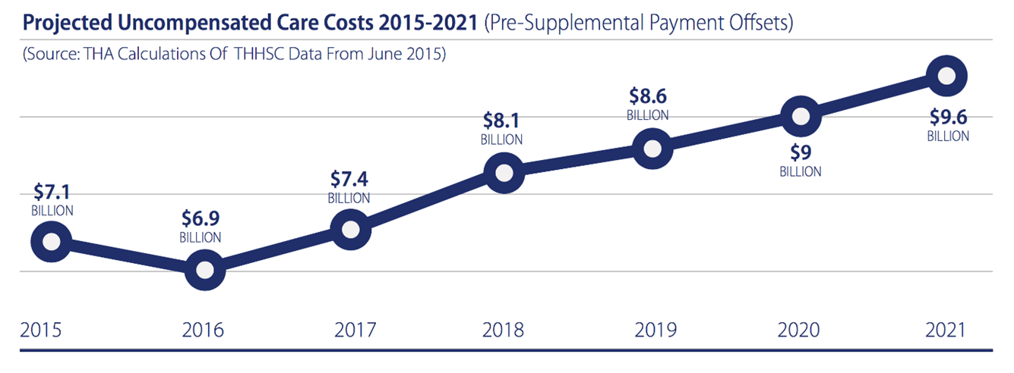
Uncompensated Care Increasing
Importance of UC funds in waiver
Medicaid shortfall remains high
Texas continues to have highest percentage and number of uninsured in nation.

Slide 18
Continue the 1115 Medicaid Transformation Waiver
Redesigned the delivery of health care in Texas
Saved more than $8 billion over the five year period
Directs $6.2 billion a year in Medicaid managed care savings to Texas hospitals and other health care providers to:
  offset some uncompensated care costs - Uncompensated Care (UC) Pool
  support 1,491 projects that improve access to needed services (BH, primary care, specialty care, chronic care) and reduces health care costs - Delivery System Reform Incentive Payment (DSRIP) Pool
The waiver was extended through December 2017
A new five-year waiver was approved on December 21, 2017.

Slide 19
New Texas Medicaid 1115 Waiver Approved by CMS
Level funding for uncompensated care and DSRIP for two years.
  Transition to modified S-10 for reporting and calculating UC payments - will not take effect until 2020.
  Transition out of DSRIP occurs over 5 years - gives the industry and the state time to identify the most effective projects and operationalize them.
  Increases allowable spending amount under “budget neutrality” cap to accommodate other means of increasing hospital reimbursement, such as NAIP, QIP and the uniform hospital rate increase program (UHRIP).
  The method of finance for the state share of Waiver payments is not addressed in the terms and conditions. The disallowance appeals process still underway. The industry and the state must ultimately figure out alternative means of financing the state share of payments.

Slide 20
New Texas Medicaid 1115 Waiver Approved by CMS
With a new Medicaid 1115 Waiver approved for Texas, hospitals’ uncompensated care funding will change beginning in 2020:
Total uncompensated care funding available and individual hospitals’ UC payments will be based on charity care costs for uninsured patients reported on a modified 2017 Worksheet S-10.
For children’s and specialty hospitals that do not use the S-10, allowable costs will come from cost reports.
UC funding no longer will include costs associated with hospitals’ bad debt or Medicaid shortfall (difference between the cost of providing a service and Medicaid reimbursement for that service).
Allowable UC costs for pool sizing purposes will not include costs from non-hospital providers, although UC payments can be made to qualifying non-hospital providers, including physician practice groups, government ambulance providers and government dental providers.
UC payments will be distributed based on reported UC costs without regard to a provider’s intergovernmental transfer payment.

Slide 21
New Texas Medicaid 1115 Waiver Approved by CMS
To ensure the financial stability of Texas hospitals and their continued ability to serve all Texans, the Texas Hospital Association is:
  Analyzing potential changes to the Medicaid disproportionate share hospital program to mitigate possible differences in UC payments among different classes of hospitals.
  Working with the Texas Health and Human Services Commission to ensure that all Texas hospitals’ UC cost data are incorporated and accounted for in the UC pool calculation.
  Modeling changes to UC payments among all hospitals.
  Representing all Texas hospitals at THHSC stakeholder workgroup meetings.

Slide 22

Questions?
_______________

